Slide 1
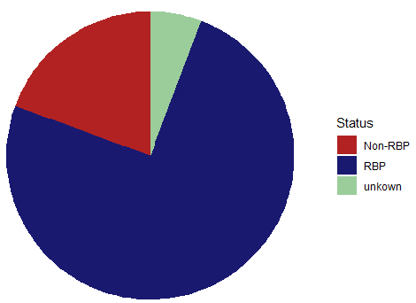
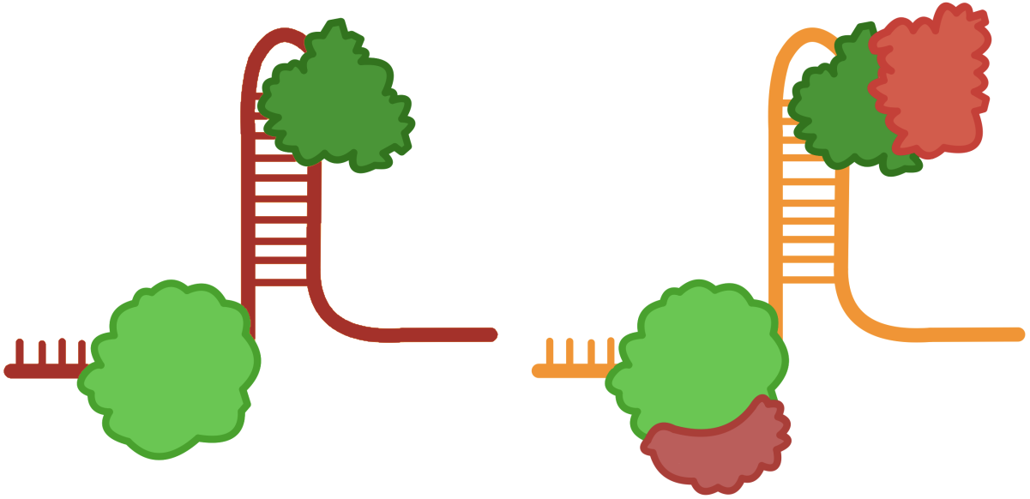
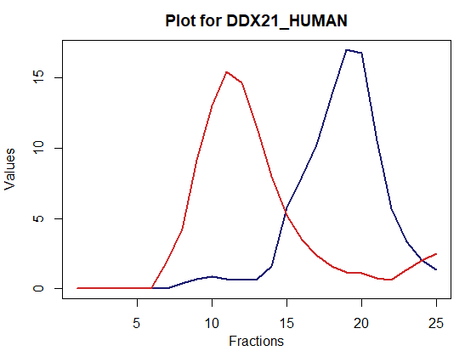
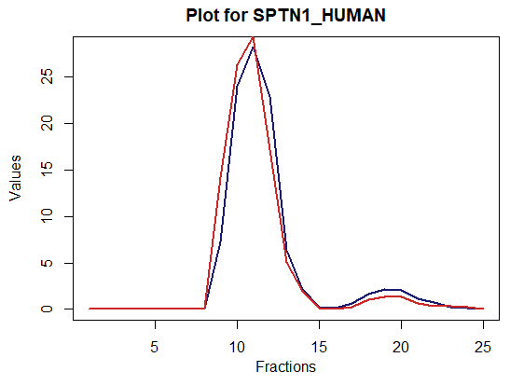
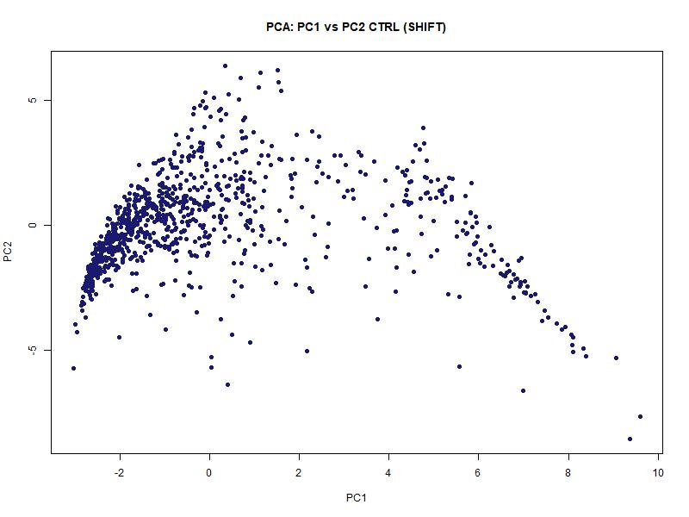
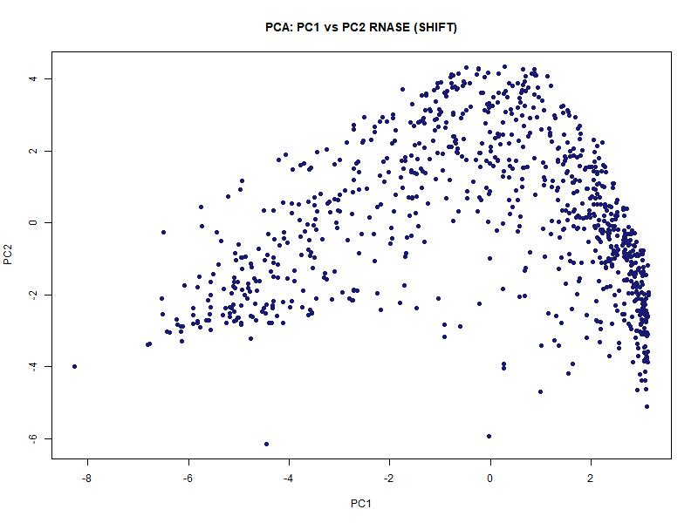
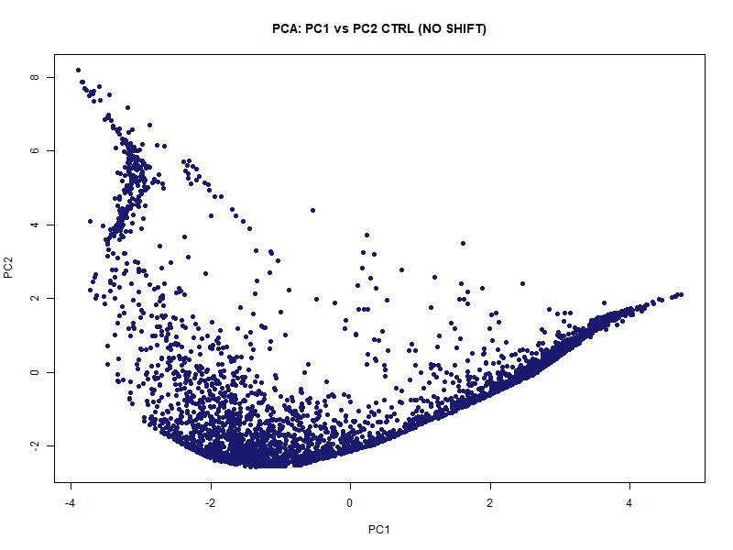
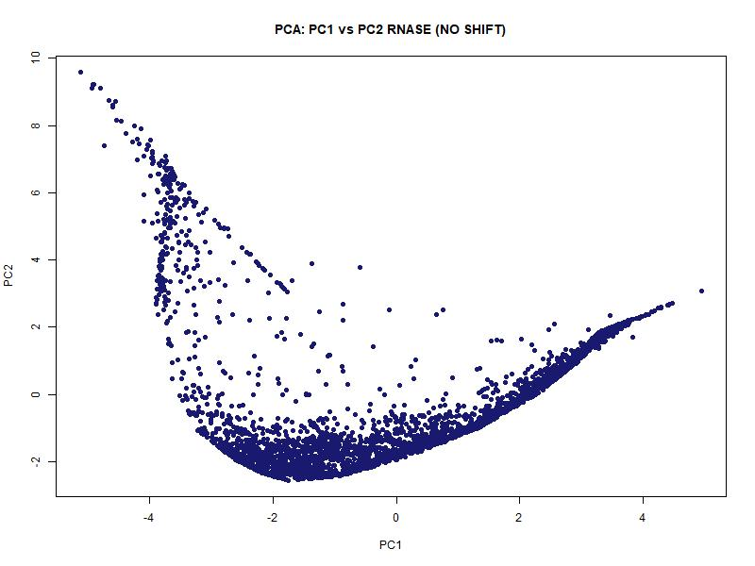
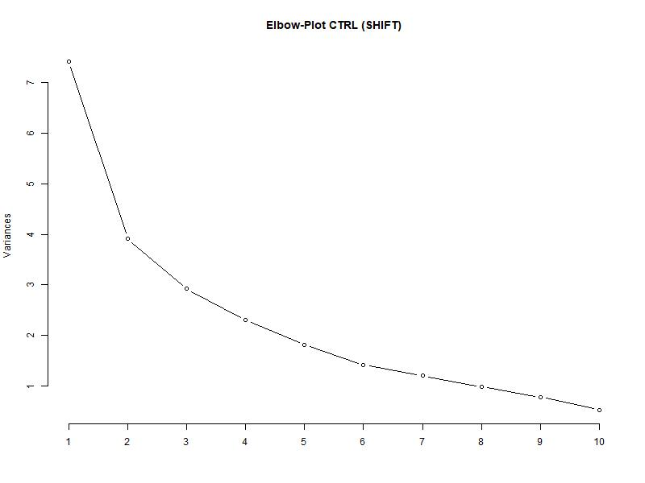
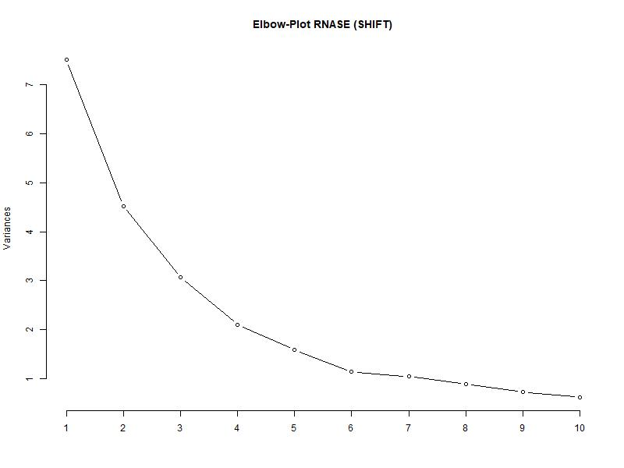
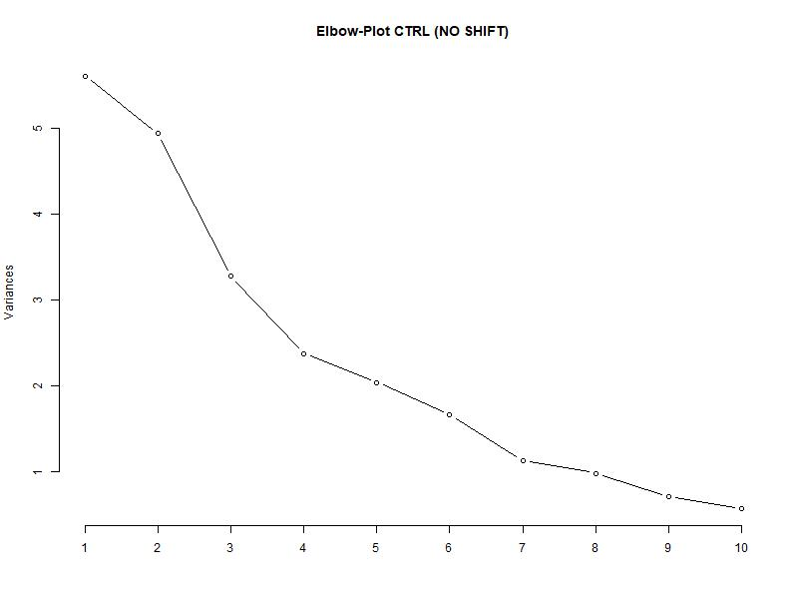
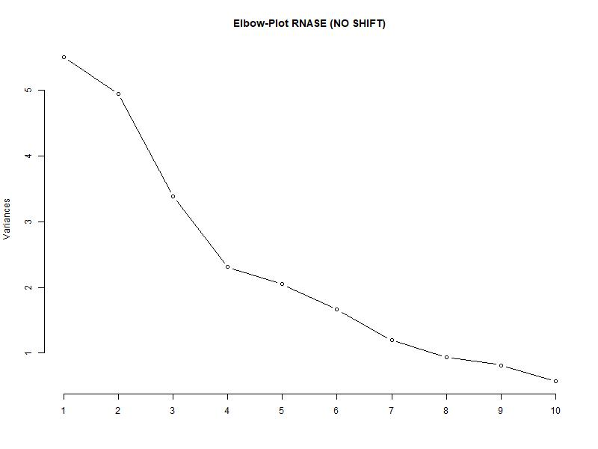
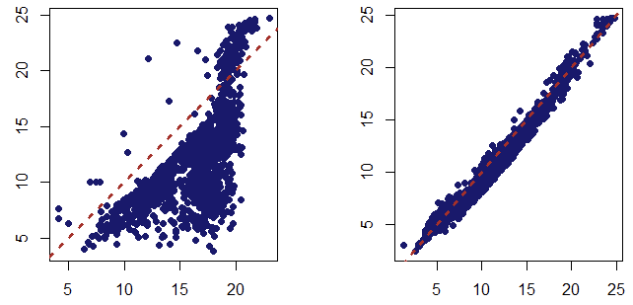
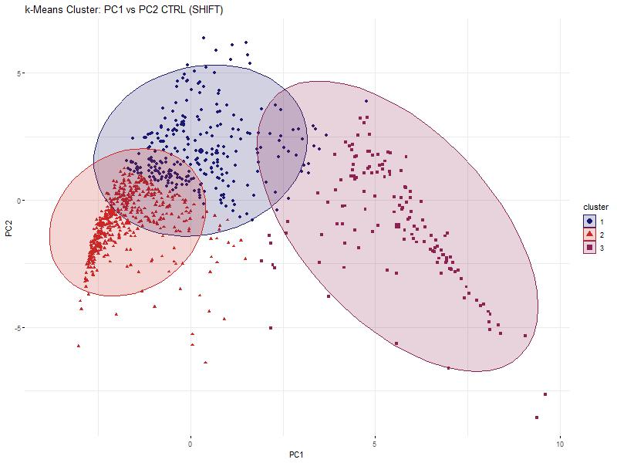
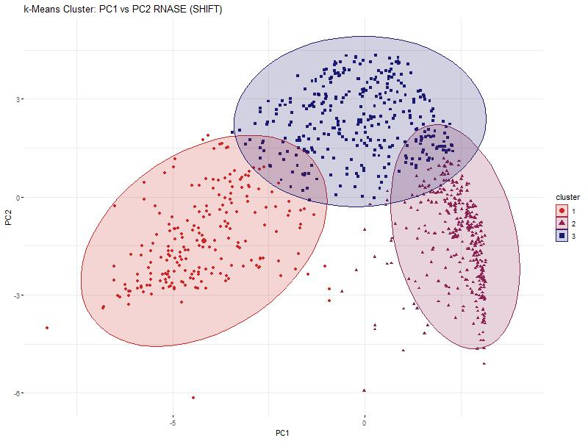
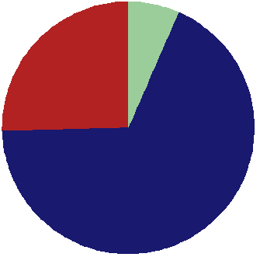
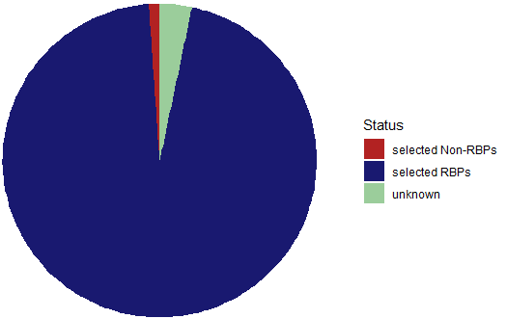
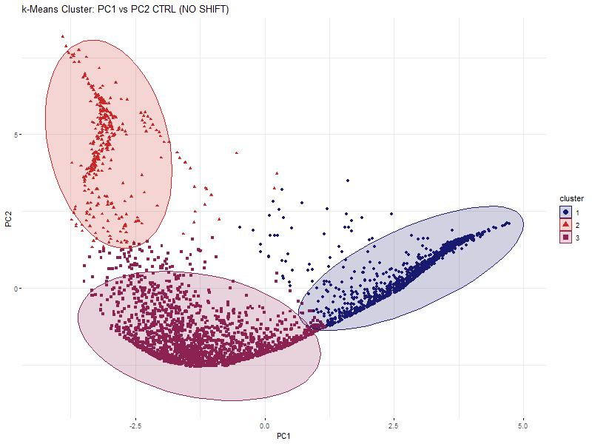
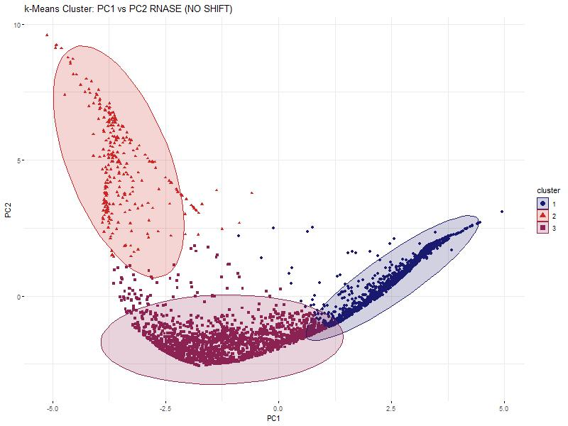

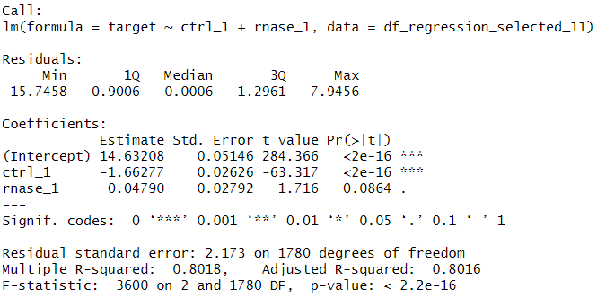
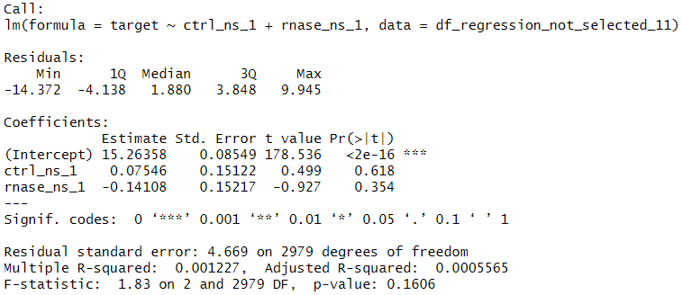

Hidden Alliances:
RNA-Dependent Protein Interactions
in Cancer Cells
Baureis, J., Ferdin, J., Nicklas, B., Wintel, L.
Data Analysis Project Molecular Biotechnology SS2025
1
Identifying RNA-Dependent Proteins from Proteomic Data
What Makes RNA-Dependent Proteins Worth Investigating?
Key Regulators: RBPs control RNA metabolism & gene expression.
Disease Links: Misregulation is tied to cancer & neurodegeneration.
Functional Clues: New RBPs hint at RNA’s role in specific pathways.
Interaction Networks: Mapping RNA-protein complexes reveals regulatory logic.
Molecular Insights: Deepens our understanding of cell cycle and cellular behavior.
1A
B
What is RNA-dependency?
The proteins interactome depends on RNA
„We want to extract RNA-dependent proteins from proteomic screens”
Key Characteristics of Our Dataset
Our dataset was generated using the R-Deep approach
4765 proteins in 25 fractions, RNASE vs. CTRL
Fig. 1 Plot of protein in data set. The data has been cleaned and normalized beforehand.
A) The protein DDX21_HUMAN is plotted. It is part of the selected proteins and shows a significant shift between RNASE and CTRL. B) The protein SPTN1_HUMAN is plotted and shows no shift.
2
Our Approach and Results
All proteins
5A
B
Center of Mass shift ≥ 2 fractions
No Center of Mass shift ≥ 2 fractions
Main maximum shift ≥ 3 fractions
No Main maximum shift ≥ 3 fractions
C
D
Correlation Value < 0.7
Correlation Value ≥ 0.7
Selected Proteins
Not Selected Proteins
Fig. 5 Principle Component Analyses and Elbowplots of the selected and the non-selected proteins. RNASE and CTRL are plotted separately for comparison.
A) PCA of the selected proteins. The data points of the RNASE compared to the CTRL make up an overall similar shape, but a shift is visible in the density of the points. B) PCA of the non-selected proteins. The points of the RNASE and CTRL form mostly the same structure. C) Elbow-Plot of the selected proteins. The knick of the elbow is at 3. D) Elbow-Plot of the non-selected proteins. The knick of the elbow is between 3 and 4. To compare selected and non-selected proteins, we decided to use 3 cluster in the kmeans clustering.
Fig. 3 Selection criteria used for the identification of RNA-dependent (selected) and not RNA-dependent (not selected) proteins
Proteins were selected based on a sequence ofcriteria. The selected proteins either had a center of mass shift ≥ 2 fractions, or had no center of mass shift, but had a main maximum shift ≥ 3 fractions, and additionally a correlation value of < 0.7 between control and rnase . The not selected proteins either had no center of mass shift ≥ 2 fractions and no main maximum shift ≥ 3 fractions, or had no center of mass shift, but a main maximum shift and additionally a correlaction value ≥ 0.7 between contro, and rnase.
Fig 4 Scatter Plots of the center of mass values between control and rnase
Each dot represents a protein. A) Scatter plot for the selected proteins. The COM values for the protein in the control approach are on the x-axis, those for the rnase approach are on the y-axis. B) Scatter plot for the not selected proteins. The COM values for the protein in the control approach are on the x-axis, those for the rnase approach are on the y-axis.
3
4
Discussion
Our Achievements
6A
B
Fig. 6 kmeans clustering of the selected and not-selected proteins
A) Shows the 3 clusters of the CTRL of the selected proteins. B) Shows the 3 clusters of the RNASE of the selected proteins. A significant shift in form and location of the clusters is noticeable. C) Shows the 3 clusters of the CTRL of the not-selected proteins. D) Shows the 3 clusters of the RNASE of the not-selected proteins. No shift in form and location is noticeable.
We found 951 different RNA dependent proteins and 3814 proteins that are not RNA dependent
Our selection criteria seem to work well for detecting RNA dependent proteins and they can be continued to be used in the future
C
D
Fig. 7 Linear regression analyses between the selected proteins and the not-selected proteins each, with global maxima of the selected CTRL proteins as target variable
A) The left regression analysis for the selected proteins describes the target variable well, the right analysis of the not-selected proteins does not. This proves, that there is a difference between the selected and not-selected proteins, and therefore, that the selection criteria worked.
5
References
7A
Sternburg et al., Global Approaches in Studying RNA-Binding Protein Interaction Networks, 2020, Trends in Biochemical Sciences.pdf
Caudron-Herger et al., R-DeeP Proteome-wide and Quantitative Identification of RNA-Dependent Proteins by Density Gradient Ultracentrifugation, 2019, Molecular Cell.pdf
Caudron-Herger et al., Identification, quantification and bioinformatic analysis of RNA-dependent proteins by RNase treatment and density gradient ultracentrifugation using R-DeeP-2020-Nature Protocols_1.pdf
Corley et al., How RNA-Binding Proteins Interact with RNA Molecules and Mechanisms, 2020, Molecular Cell.pdf
Rajagopal et al., An atlas of RNA-dependent proteins in cell division reveals the riboregulation of mitotic protein-protein interactions. Nat. Commun. 16, 2325 (2025).pdf

